Slide 1




Rotaract Peace Conference
11-13.03.2022
1/06/2022

Slide 2
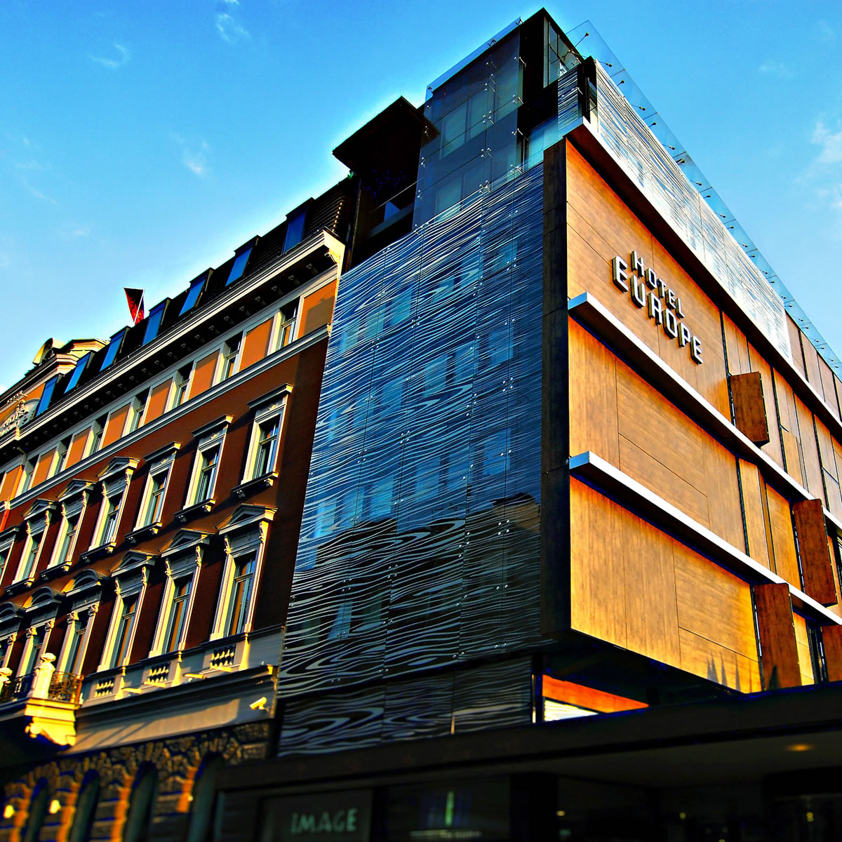
Location: Hotel Europe Sarajevo
https://www.booking.com/hotel/ba/europa-sarajevo.hr.html
https://www.hoteleuropegroup.ba/en/europe

Slide 3


What to do on Friday 11th?
Harmony Concert organized by Rotary Club Sarajevo (Tickets 50euros) (optional)
Sarajevo night tour (optional)
Get together drinks (not official) (optional)

Slide 4

Agenda

Slide 5
Sessions
ERIC SESSION
Peacing it together
Rotaract united for Nepal
ROTARACT MEDITERRANEAN
Mosaic of Cultures
ROTARACT SARAJEVO
Rotary Club Sarajevo - HARMONY PROJECT
Social Project
Bridging Cultures Through Dialogue

Slide 6
Panelists
ERIC SESSION
Peter Neuner
Bernhard Pribyl-Kranewitter
Aleksandar Matic
ROTARACT MEDITERRANEAN
Bilal Ayoubi (Lebanon)
Salva Amoros (Spain)
Moderator: Tugce Tunalilar (Turkey)
Workshop Facilatator: Marwa Ayoubi (Lebanon)
ROTARACT SARAJEVO
ROTARY SARAJEVO - HARMONY PROJECT
Amela Brčaninović

Slide 7

What to do on Sunday 13th?
Sarajevo city tour (optional)
Social Project (if needed)

Slide 8
Packages
Jahorina
190 EURO
380 KM
Accommodation at Hotel Europe *****
2 nights
Conference
Lunch (drinks not included)
Dinner(drinks not included)
Bjelasnica
150 EURO
300 KM
Accommodation at Hotel Europe*****
1 night
Conference
Lunch (drinks not included)
Dinner(drinks not included)
Trebevic
70 EURO
140KM
Conference
Lunch (drinks not included)
Dinner(drinks not included)

Slide 9



Thank you

